Slide 1

What are Graphs?
Not
General meaning in everyday math:
A plot or chart of numerical data using a coordinate system.
Technical meaning in discrete mathematics:
A particular class of discrete structures (to be defined) that is useful for representing relations and has a convenient webby-looking graphical representation.
School of Computer Science, BUPT

Slide 2
Königsberg Bridge problem
The residents of Königsberg, Germany, wondered if it was possible to take a walking tour of the town that crossed each of the seven bridges over the Pregel River exactly once.
  Leonard Euler 1736 (father of graph theory)
School of Computer Science, BUPT

Slide 3
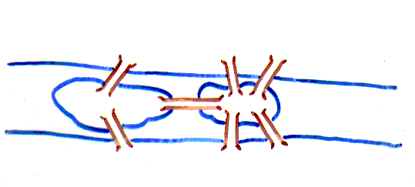
Königsberg Bridge problem
Picture only what is essential to the problem.
School of Computer Science, BUPT

Slide 4
Königsberg Bridge problem
Is it possible to start at some node and take a walk that uses each edge exactly once, and ends at the starting node?
School of Computer Science, BUPT

Slide 5
Königsberg Bridge problem
You can redraw the original picture as long as for every edge between nodes i and j in the original you put an edge between nodes i and j in the redrawn version (and you put no other edges in the redrawn version)
1
2
2
3
4
1
3
4
School of Computer Science, BUPT

Slide 6
Can you see why?
Euler
  Has no tour that uses each edge exactly once.
  (Even if we allow the walk to start and finish in different places.)
School of Computer Science, BUPT

Slide 7
Applications of Graphs
Potentially anything (graphs can represent relations, relations can describe the extension of any predicate).
Apps in networking, scheduling, flow optimization, circuit design, path planning.
More apps: Geneology analysis, computer game-playing, program compilation, object-oriented design, …
School of Computer Science, BUPT

Slide 8
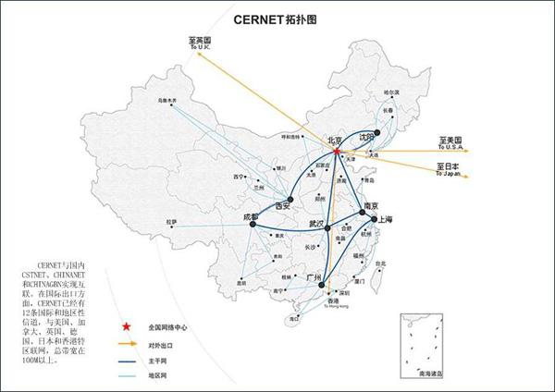
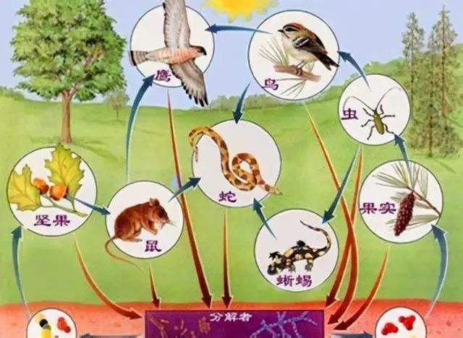
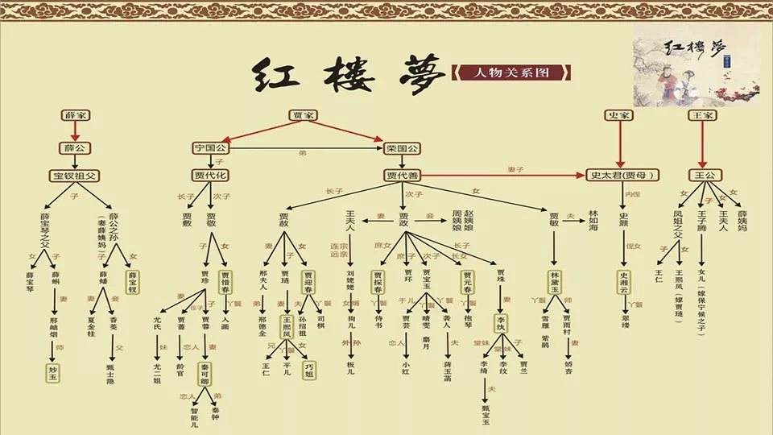

Slide 9
Types of Graphs
Simple graph
Multigraph
Pseudograph
Simple directed graph
Directed multigraph
Mixed graph
School of Computer Science, BUPT

Slide 10
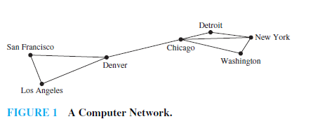
P674
School of Computer Science, BUPT

Slide 11
Simple Graphs
Correspond to symmetric,
irreflexive binary relations R.
A simple graph G=(V,E)
consists of:
  V ,a nonempty set of vertices or nodes
  E ,a set of edges / arcs / links: unordered pairs of distinct elements u,v ∈ V, such that uRv.
Visual Representation
of a Simple Graph
School of Computer Science, BUPT

Slide 12
Example of a Simple Graph
Let V be the set of states in the far-southeastern U.S.:
  I.e., V={FL, GA, AL, MS, LA, SC, TN, NC}
Let E={{u,v}|u adjoins v}
  ={{FL,GA},{FL,AL},{FL,MS},
  {FL,LA},{GA,AL},{AL,MS},
  {MS,LA},{GA,SC},{GA,TN},
  {SC,NC},{NC,TN},{MS,TN},
  {MS,AL}}
TN
NC
MS
AL
SC
GA
LA
FL
School of Computer Science, BUPT

Slide 13
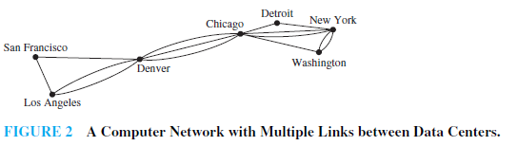
P674
School of Computer Science, BUPT

Slide 14
Multigraphs
Like simple graphs, but there may be more than one edge connecting two given nodes.
A multigraph G=(V, E, f ) consists of a set V of vertices, a set E of edges (as primitive objects), and a function
f:E→{{u,v}|u,v∈V ∧ u≠v}.
E.g., nodes are cities, edges
are segments of major highways.
Parallel
edges
School of Computer Science, BUPT

Slide 15
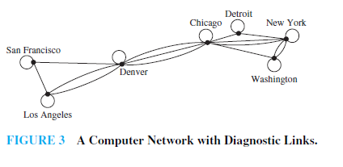
P674
School of Computer Science, BUPT

Slide 16
Pseudographs
Like a multigraph, but edges connecting a node to itself are allowed. (R may be reflexive.)
A pseudograph G=(V, E, f ) where
f:E→{{u,v}|u,v∈V}. Edge e∈E is a loop if f(e)={u,u}={u}.
E.g., nodes are campsites
in a state park, edges are
hiking trails through the
woods.
School of Computer Science, BUPT

Slide 17
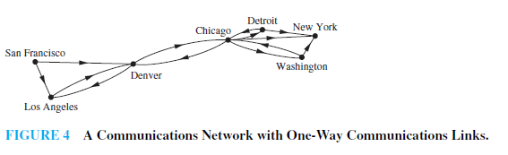
P675
School of Computer Science, BUPT

Slide 18
Directed Graphs
Correspond to arbitrary binary relations R, which need not be symmetric.
A directed graph (V,E) consists of a set of vertices V and a set of edges E that are ordered pairs of elements of V.
E.g.: V = set of People,
E={(x,y) | x loves y}
School of Computer Science, BUPT

Slide 19
simple directed graph
When a directed graph has no loops and has no multiple directed edges, it is called a simple directed graph.
School of Computer Science, BUPT

Slide 20
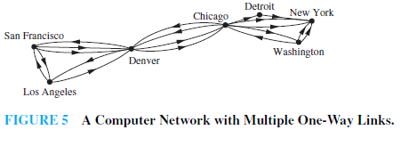
p675
School of Computer Science, BUPT

Slide 21
Directed Multigraphs
Like directed graphs, but there may be more than one arc from a node to another.
A directed multigraph G=(V, E, f ) consists of a set V of vertices, a set E of edges, and a function f:E→V×V.
E.g., V=web pages,
E=hyperlinks. The WWW is
a directed multigraph...
School of Computer Science, BUPT

Slide 22
Mixed graph
A graph with both directed and undirected edges is called a mixed graph.
School of Computer Science, BUPT

Slide 23
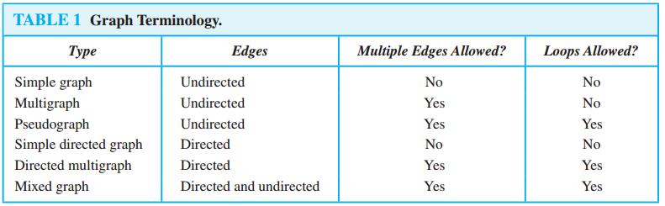
Types of Graphs: Summary
Summary of the book’s definitions.
Keep in mind this terminology is not fully standardized across different authors...
School of Computer Science, BUPT

Slide 24
Graph models
Social Networks
Information Networks
Software Design Applications
Transportation Networks
Biological Networks
Tournaments
School of Computer Science, BUPT

Slide 25
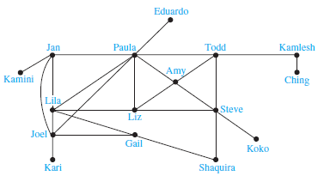
Acquaintanceship Graph
School of Computer Science, BUPT

Slide 26
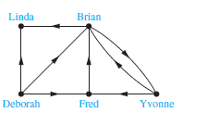
Influence Graphs
School of Computer Science, BUPT

Slide 27
Collaboration Graphs
A collaboration graph is used to model social networks where two people are related by working together in a particular way.
School of Computer Science, BUPT

Slide 28
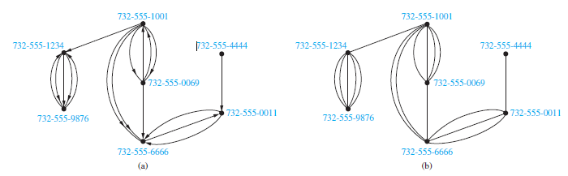
Call graphs
School of Computer Science, BUPT

Slide 29
The Web graph
The WorldWideWeb can be modeled as a directed graph where each Web page is represented by a vertex and where an edge starts at the Web page a and ends at the Web page b if there is a link on a pointing to b.
School of Computer Science, BUPT

Slide 30
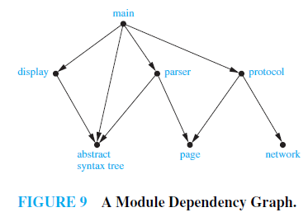
module Dependency graph
School of Computer Science, BUPT

Slide 31
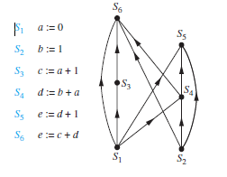
Precedence Graphs and Concurrent Processing
School of Computer Science, BUPT

Slide 32
Transportation Graphs
Graph models are extensively used in the study of transportation networks.
Airline networks can be modeled using directed multigraphs where
  airports are represented by vertices
  each flight is represented by a directed edge from the vertex representing the departure airport to the vertex representing the destination airport
Road networks can be modeled using graphs where
  vertices represent intersections and edges represent roads.
  undirected edges represent two-way roads and directed edges represent one-way roads.

Slide 33
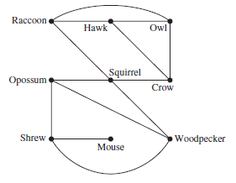
Niche Overlap Graphs in Ecology
School of Computer Science, BUPT

Slide 34
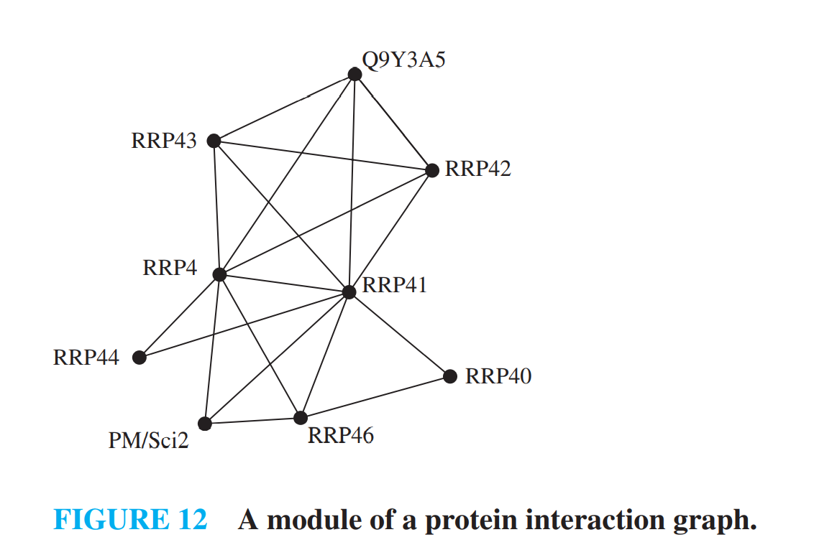
Protein Interaction Graphs

Slide 35
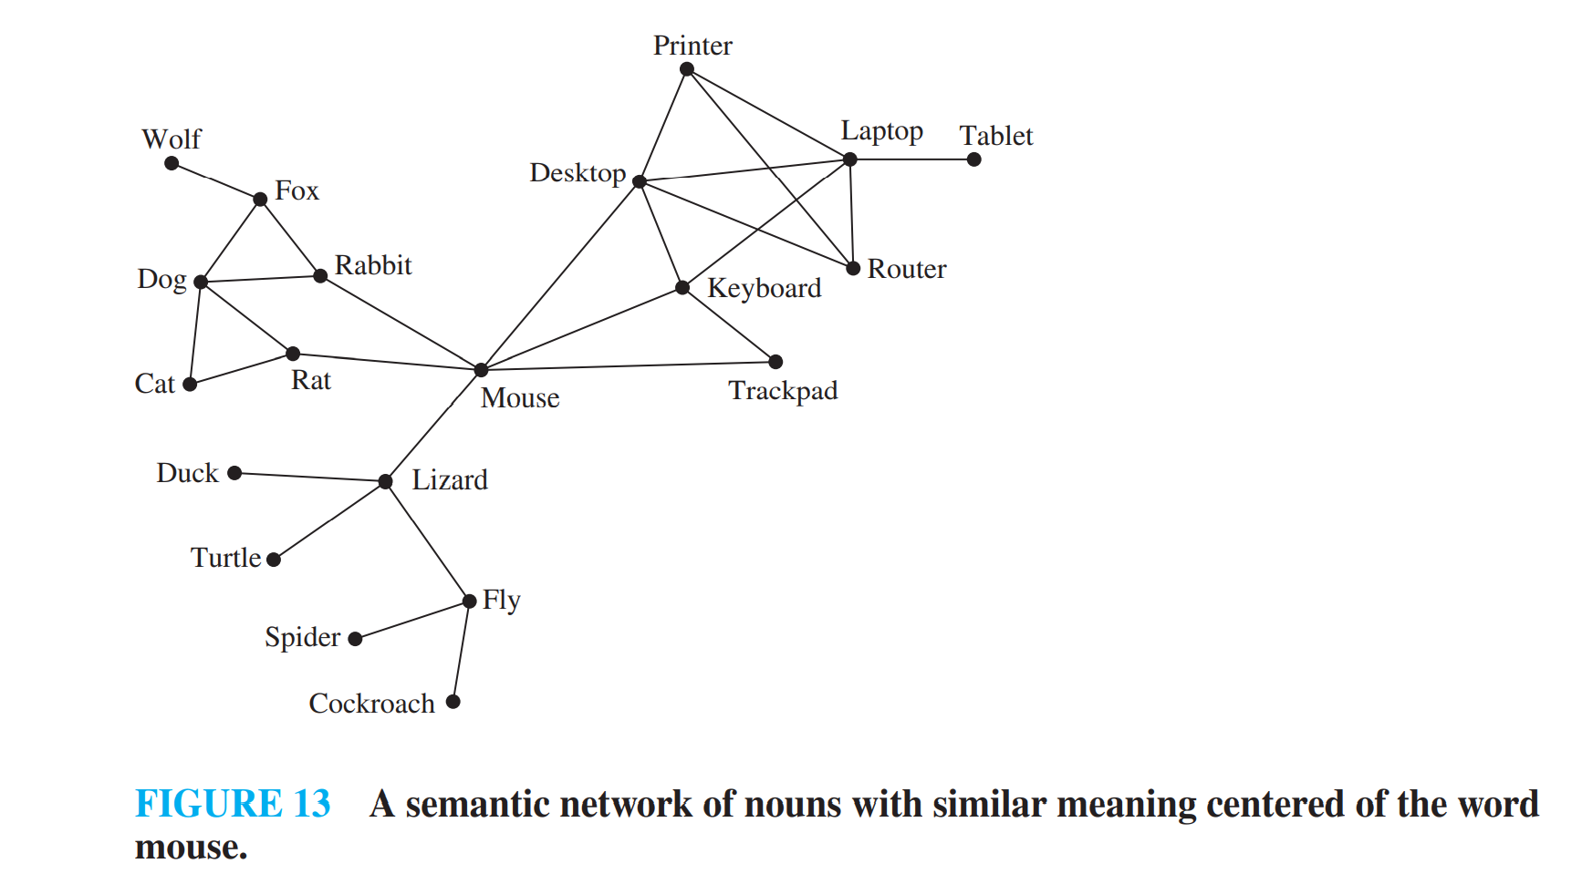
semantic networks

Slide 36
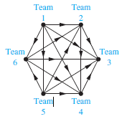
Round-Robin Tournaments
School of Computer Science, BUPT

Slide 37
Homework
§10.1
  24,36
School of Computer Science, BUPT

